Slide 1

Internship
Report
PearlRain Digital LLP

Slide 2
Company Overview
PearlRain Digital LLP stands as a distinguished Outsourced Product Development Company, revered for its prowess in high-technology software development.
Their forte spans a comprehensive spectrum of services, ranging from conceiving novel products to orchestrating the entire life cycle management process.
They perceive themselves as the linchpin behind their clients' competitive edge, harnessing cutting-edge technologies to catalyze innovation and broaden their product portfolios.
With a widespread footprint in research and development, coupled with product development, they aspire to redefine industry benchmarks and emerge as a vanguard of innovative thought.
Their dedication is unwavering, focused on enhancing user experiences through strategic design, spearheading groundbreaking AI & Blockchain projects, crafting web and mobile applications, and pioneering cloud-based initiatives.
2
Page

Slide 3
Company Overview
Vision:
To become a competitive advantage for our customers in utilizing the latest technology to build compelling new products and to quickly expand their product portfolio.
PearlRain Digital team desires to leverage its global exposure to product development to make a significant contribution in shaping Outsourced Product Development industry and to establish itself as a thought leader in this space.
Core Values:
Trust, Transparency and Freedom of Expression
Innovation
Integrity
Customer-Centricity
Verticals:
HealthTech
FinTech
Blockchain
E-commerce
3
Page

Slide 4




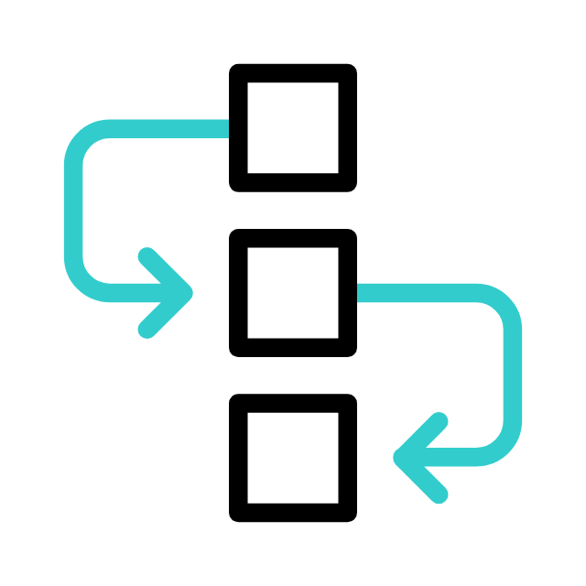
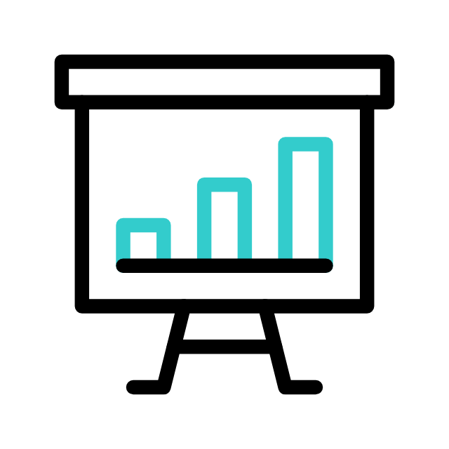
Business Problem
Data Info
Sales
Dashboard
Project
Future
Work
Query Output
Workflow
Dashboards
4
Page

Slide 5
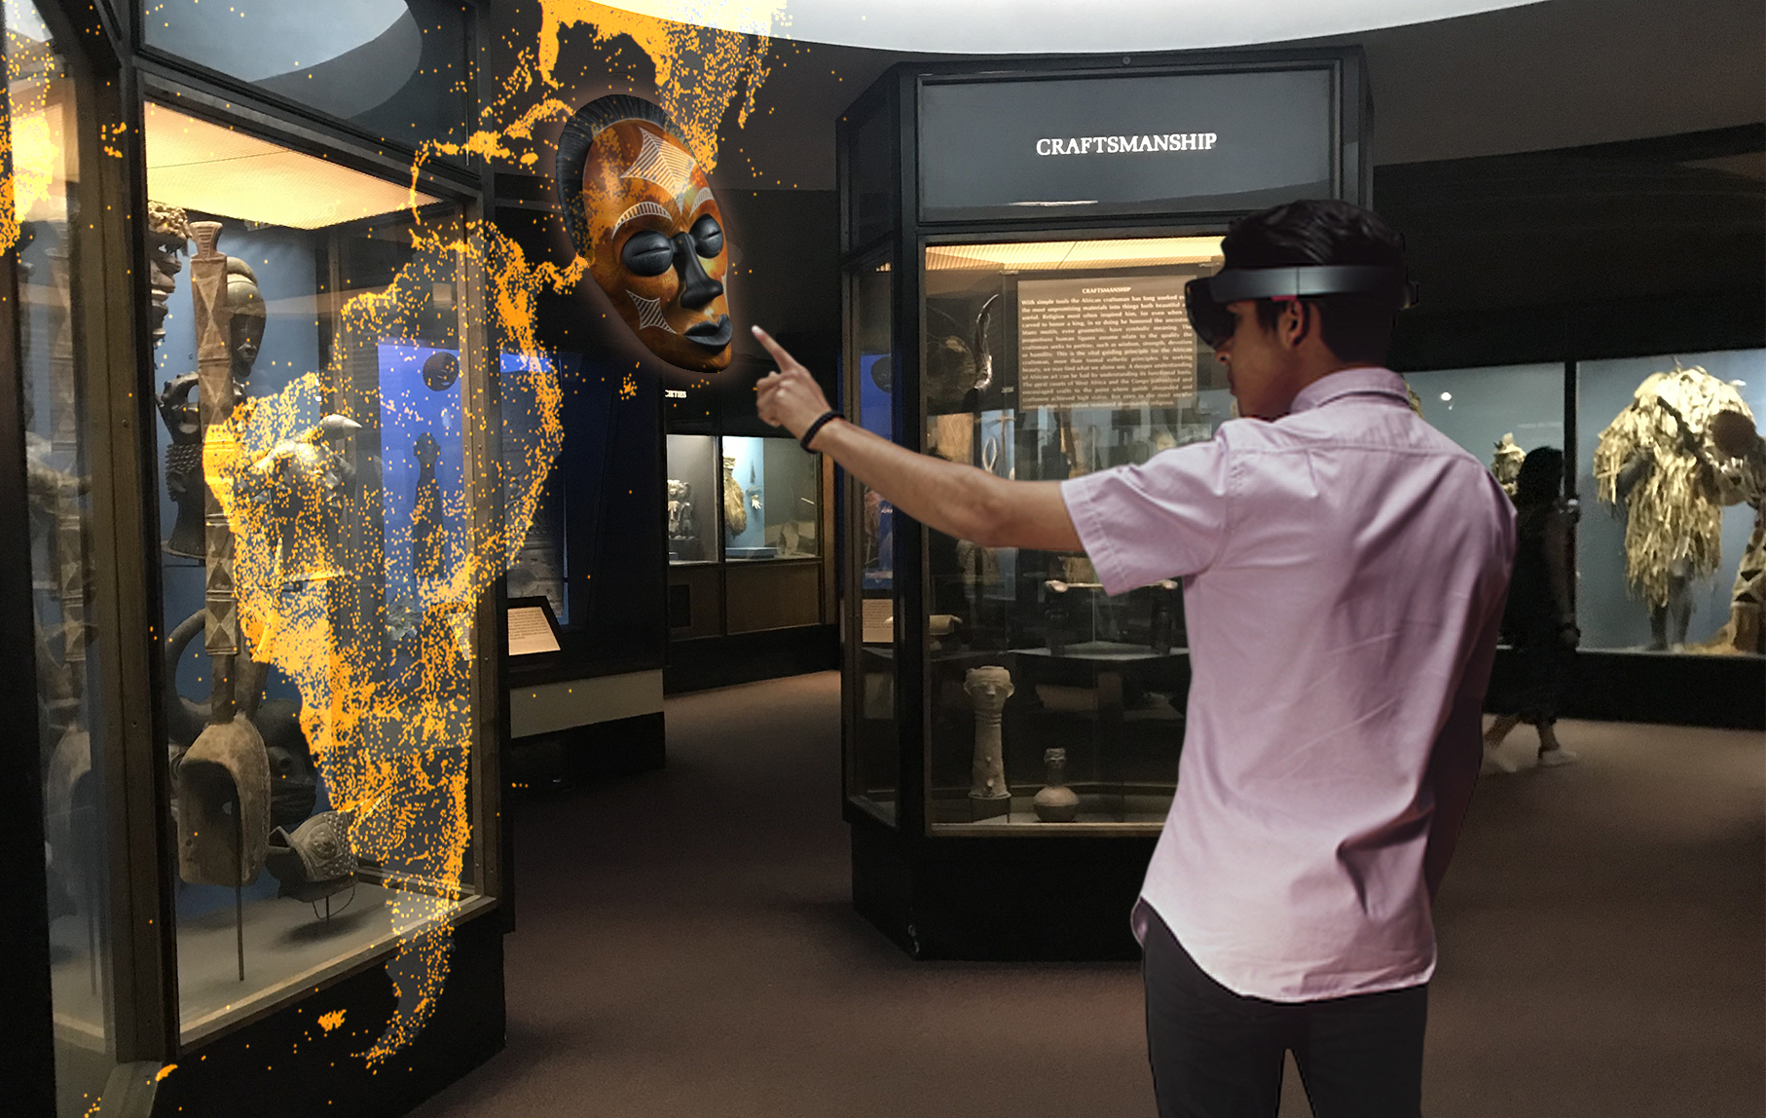
Problem Statement
“How might we develop a comprehensive and actionable understanding of client and customer behaviors, preferences, and needs through data analysis to drive informed decision-making and enhance overall product satisfaction and profitability?”
5
Page

Slide 6

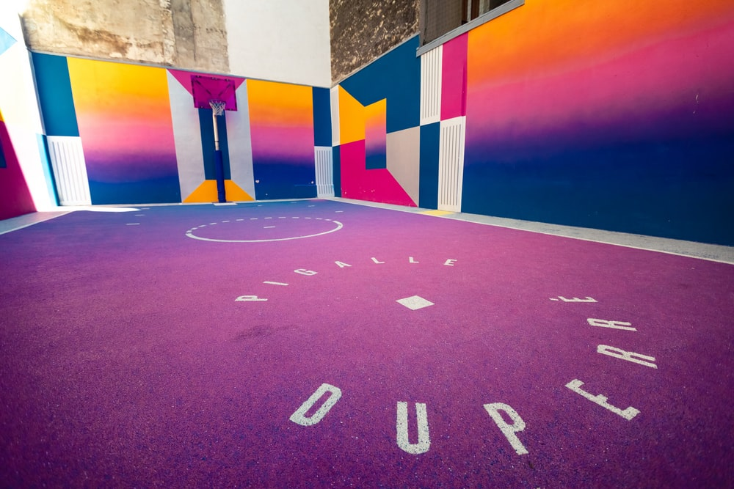
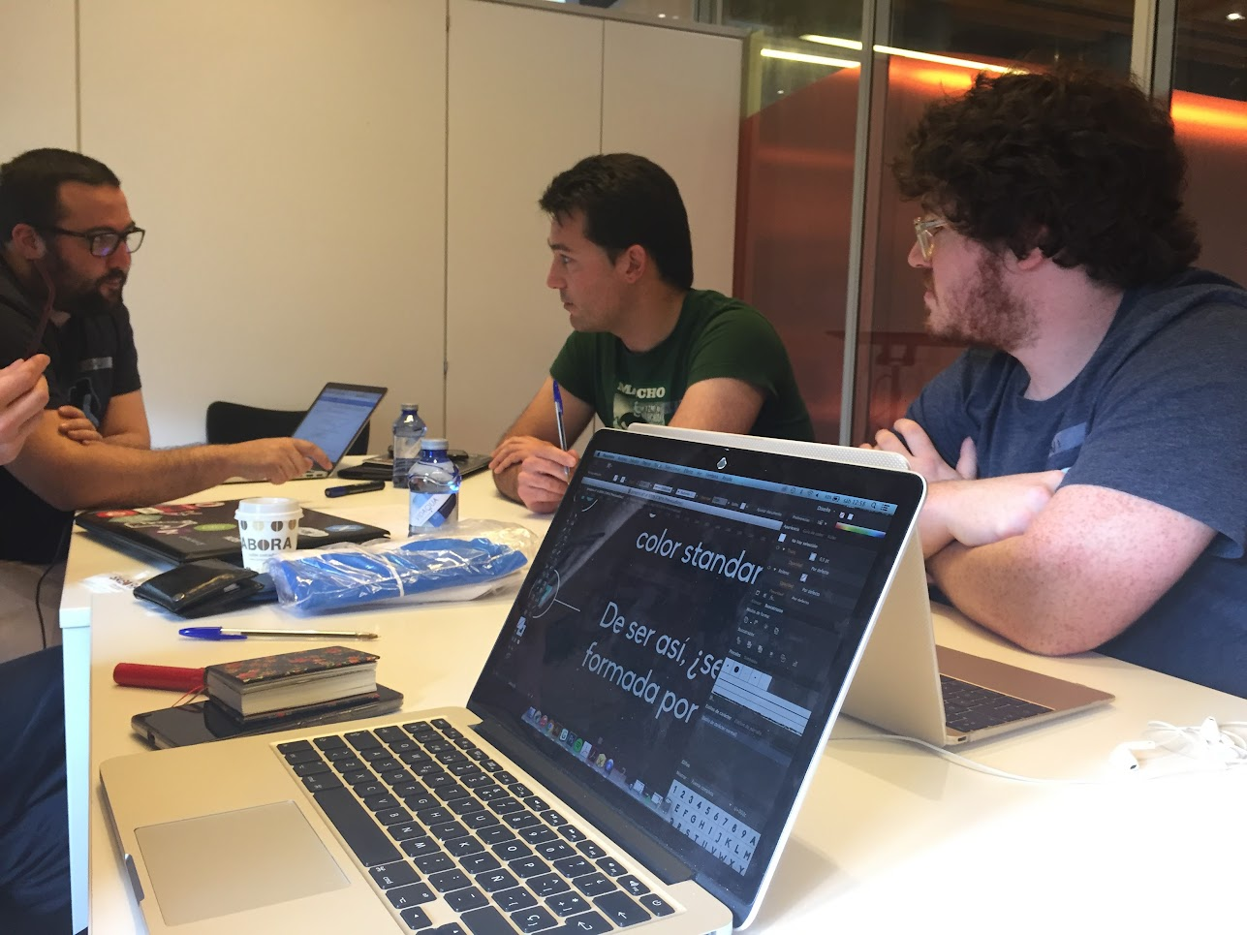
Data Info
Data Description
Our project involves Excel files containing data on 50 products, 500 client profiles, and over 1000 transaction details. Additional sheets cover contract, manufacturing, and rating specifics, offering a comprehensive view for strategic decision-making.
Data Dictionary
A Data Dictionary is a reference guide providing detailed descriptions and metadata about data elements within a database, including names, types, formats, and constraints.
ER- Diagram
An Entity-Relationship (ER) diagram is a visual representation illustrating the relationships between entities in a database, typically depicted by boxes (entities) and lines (relationships) connecting them.
6
Page
Notes:
https://unsplash.com/photos/pqzRfBhd9r0
https://unsplash.com/photos/lFhyR3GVOXE

Slide 7
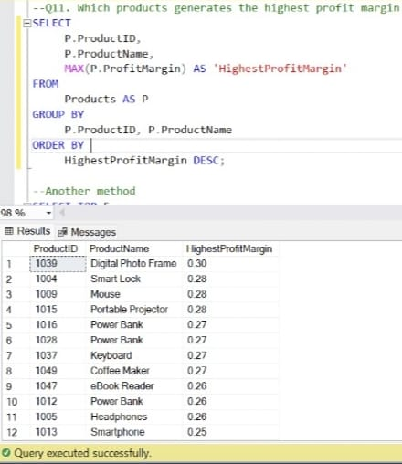
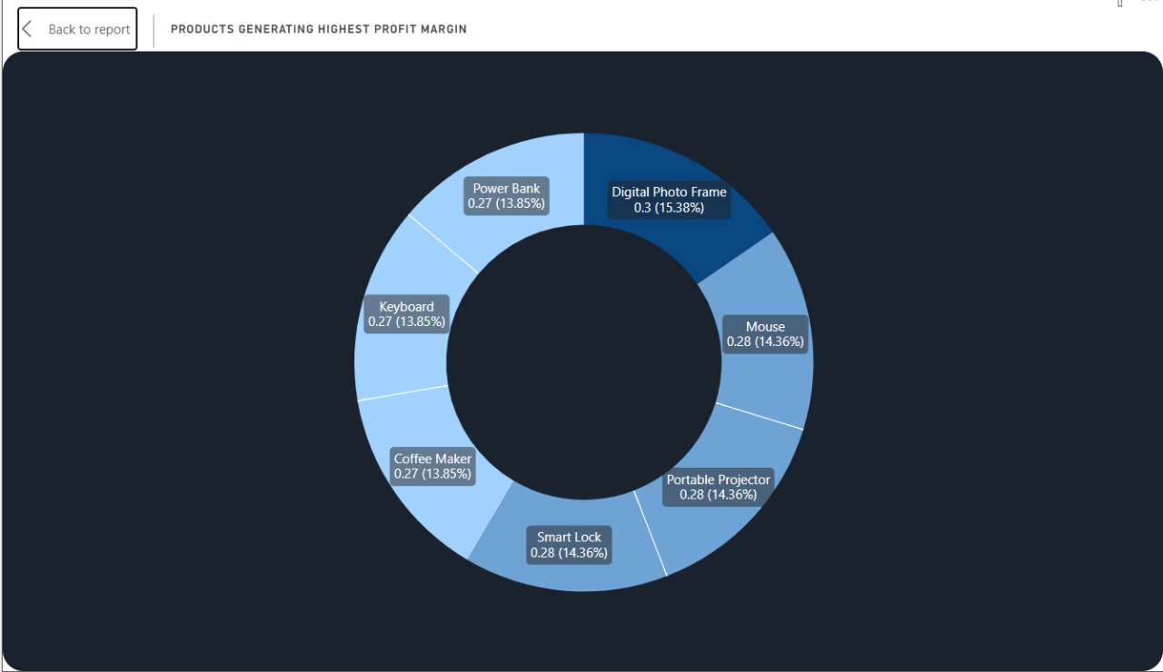
Query Output
01
Which Products generates the highest profit margin
Comparing to Dashboard
7
Page
Notes:
https://unsplash.com/photos/lFhyR3GVOXE

Slide 8
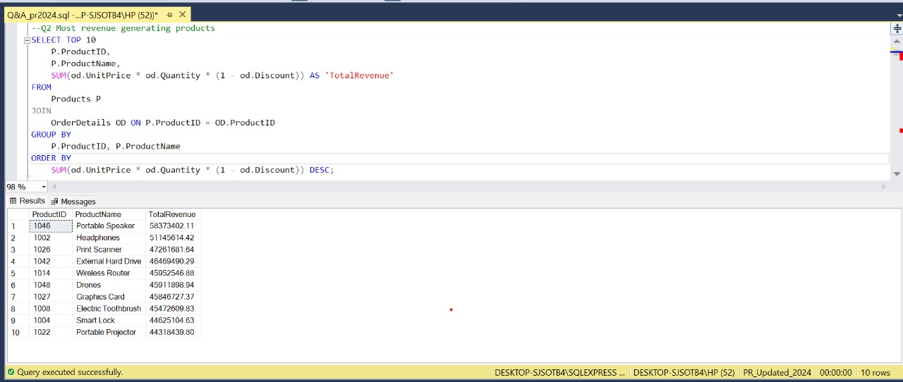
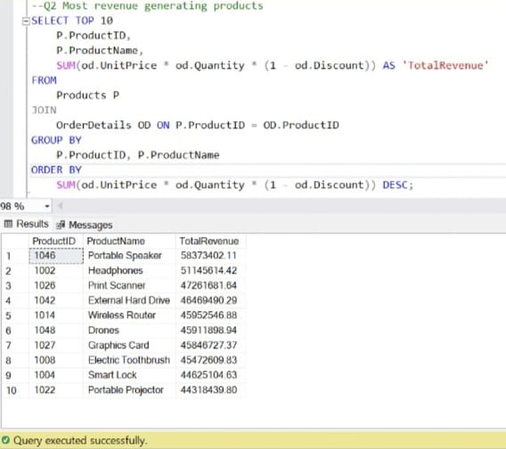
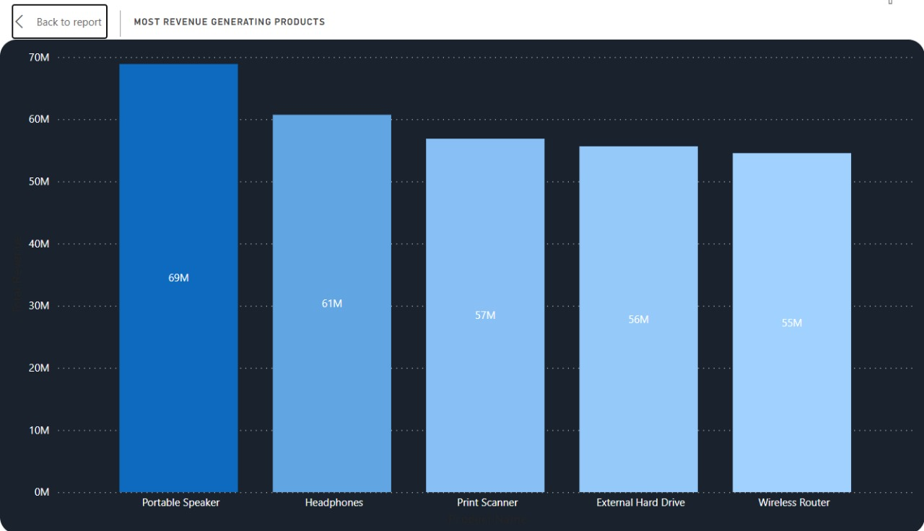
Query Output
02
Most revenue generating Products
Comparing to Dashboard
8
Page
Notes:
https://unsplash.com/photos/lFhyR3GVOXE

Slide 9

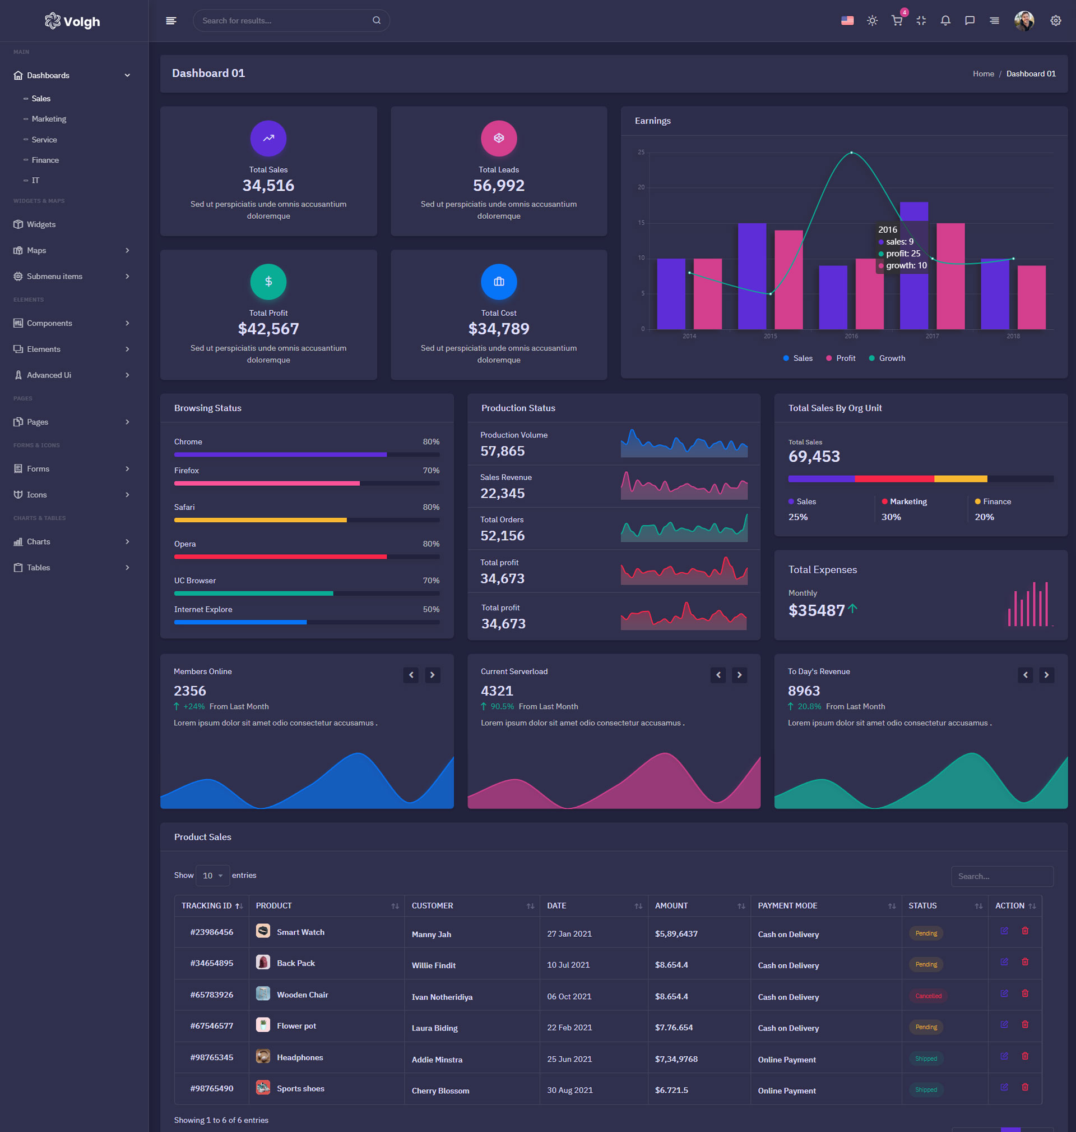
Dashboards
A Dashboard is a visual tool used to present key data and insights in a concise and accessible format, aiding decision-making processes. These dashboards are built using Power BI and rely on data stored in a Microsoft SQL Server database.
The integration between the database and Power BI ensures that the dashboards display real-time or near-real-time information, enabling stakeholders to monitor performance and identify trends effectively.
This setup streamlines data analysis and facilitates informed decision-making within organizations.
9
Page

Slide 10
Market Basket Analysis
Market basket analysis is a method used in retail to uncover product relationships based on customer purchase patterns. By analyzing which items are frequently bought together, businesses gain insights into customer behavior and preferences, enabling them to optimize inventory, layout, and merchandising strategies. This analysis also supports cross-selling efforts by identifying opportunities to suggest complementary products, enhancing the shopping experience and driving revenue through targeted promotions and personalized recommendations.
This technique not only enhances the shopping experience for customers by suggesting complementary products but also empowers retailers to make data-driven decisions that drive efficiency, improve customer satisfaction, and ultimately boost revenue.
10
Page

Slide 11

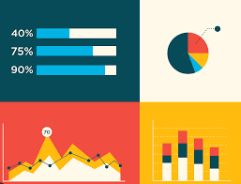


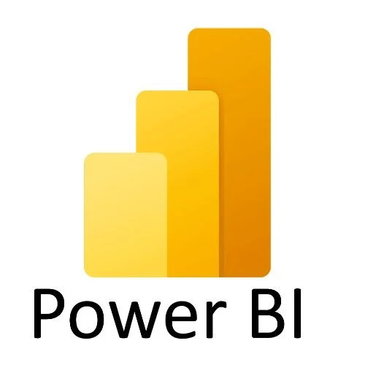
Workflow
A workflow is a sequence of steps or tasks that outline how a specific process is completed from start to finish. It defines the order of activities, the individuals or roles responsible for each task, and any dependencies or conditions that need to be met for the process to proceed smoothly. Workflows are commonly used to streamline operations, improve efficiency, and ensure consistency in task execution.
Company storage system and from here data is Exported to our database
Importing data from Navision to our database for better handling and increase the scalability
Creation of “Reports & Dashboards” as
per the requirements and publishing it.
Visualizations
to get the
meaningful
insight
11
Page
Notes:
https://unsplash.com/photos/jJT2r2n7lYA

Slide 12
Future Enhancement
Advanced Predictive
Analytics:
Leverage machine learning for more accurate trend forecasting and pattern identification.
Enable instant analysis of streaming data, facilitating quick decision-making.
Empower users with drill-down options, customizable filters, and dynamic exploration for deeper insights.
Enrich analysis by integrating with external data sources and third-party applications.
Facilitate intuitive interaction through voice or text commands for enhanced accessibility.
Ensure robust security measures and compliance features for data protection and regulatory adherence.
Real-time Data Processing:
Enhanced User Interactivity:
Integration with External Systems:
Natural Language Processing (NLP) Integration:
Enhanced Security and Compliance:
12
Page
Notes:
https://unsplash.com/photos/jJT2r2n7lYA

Slide 13
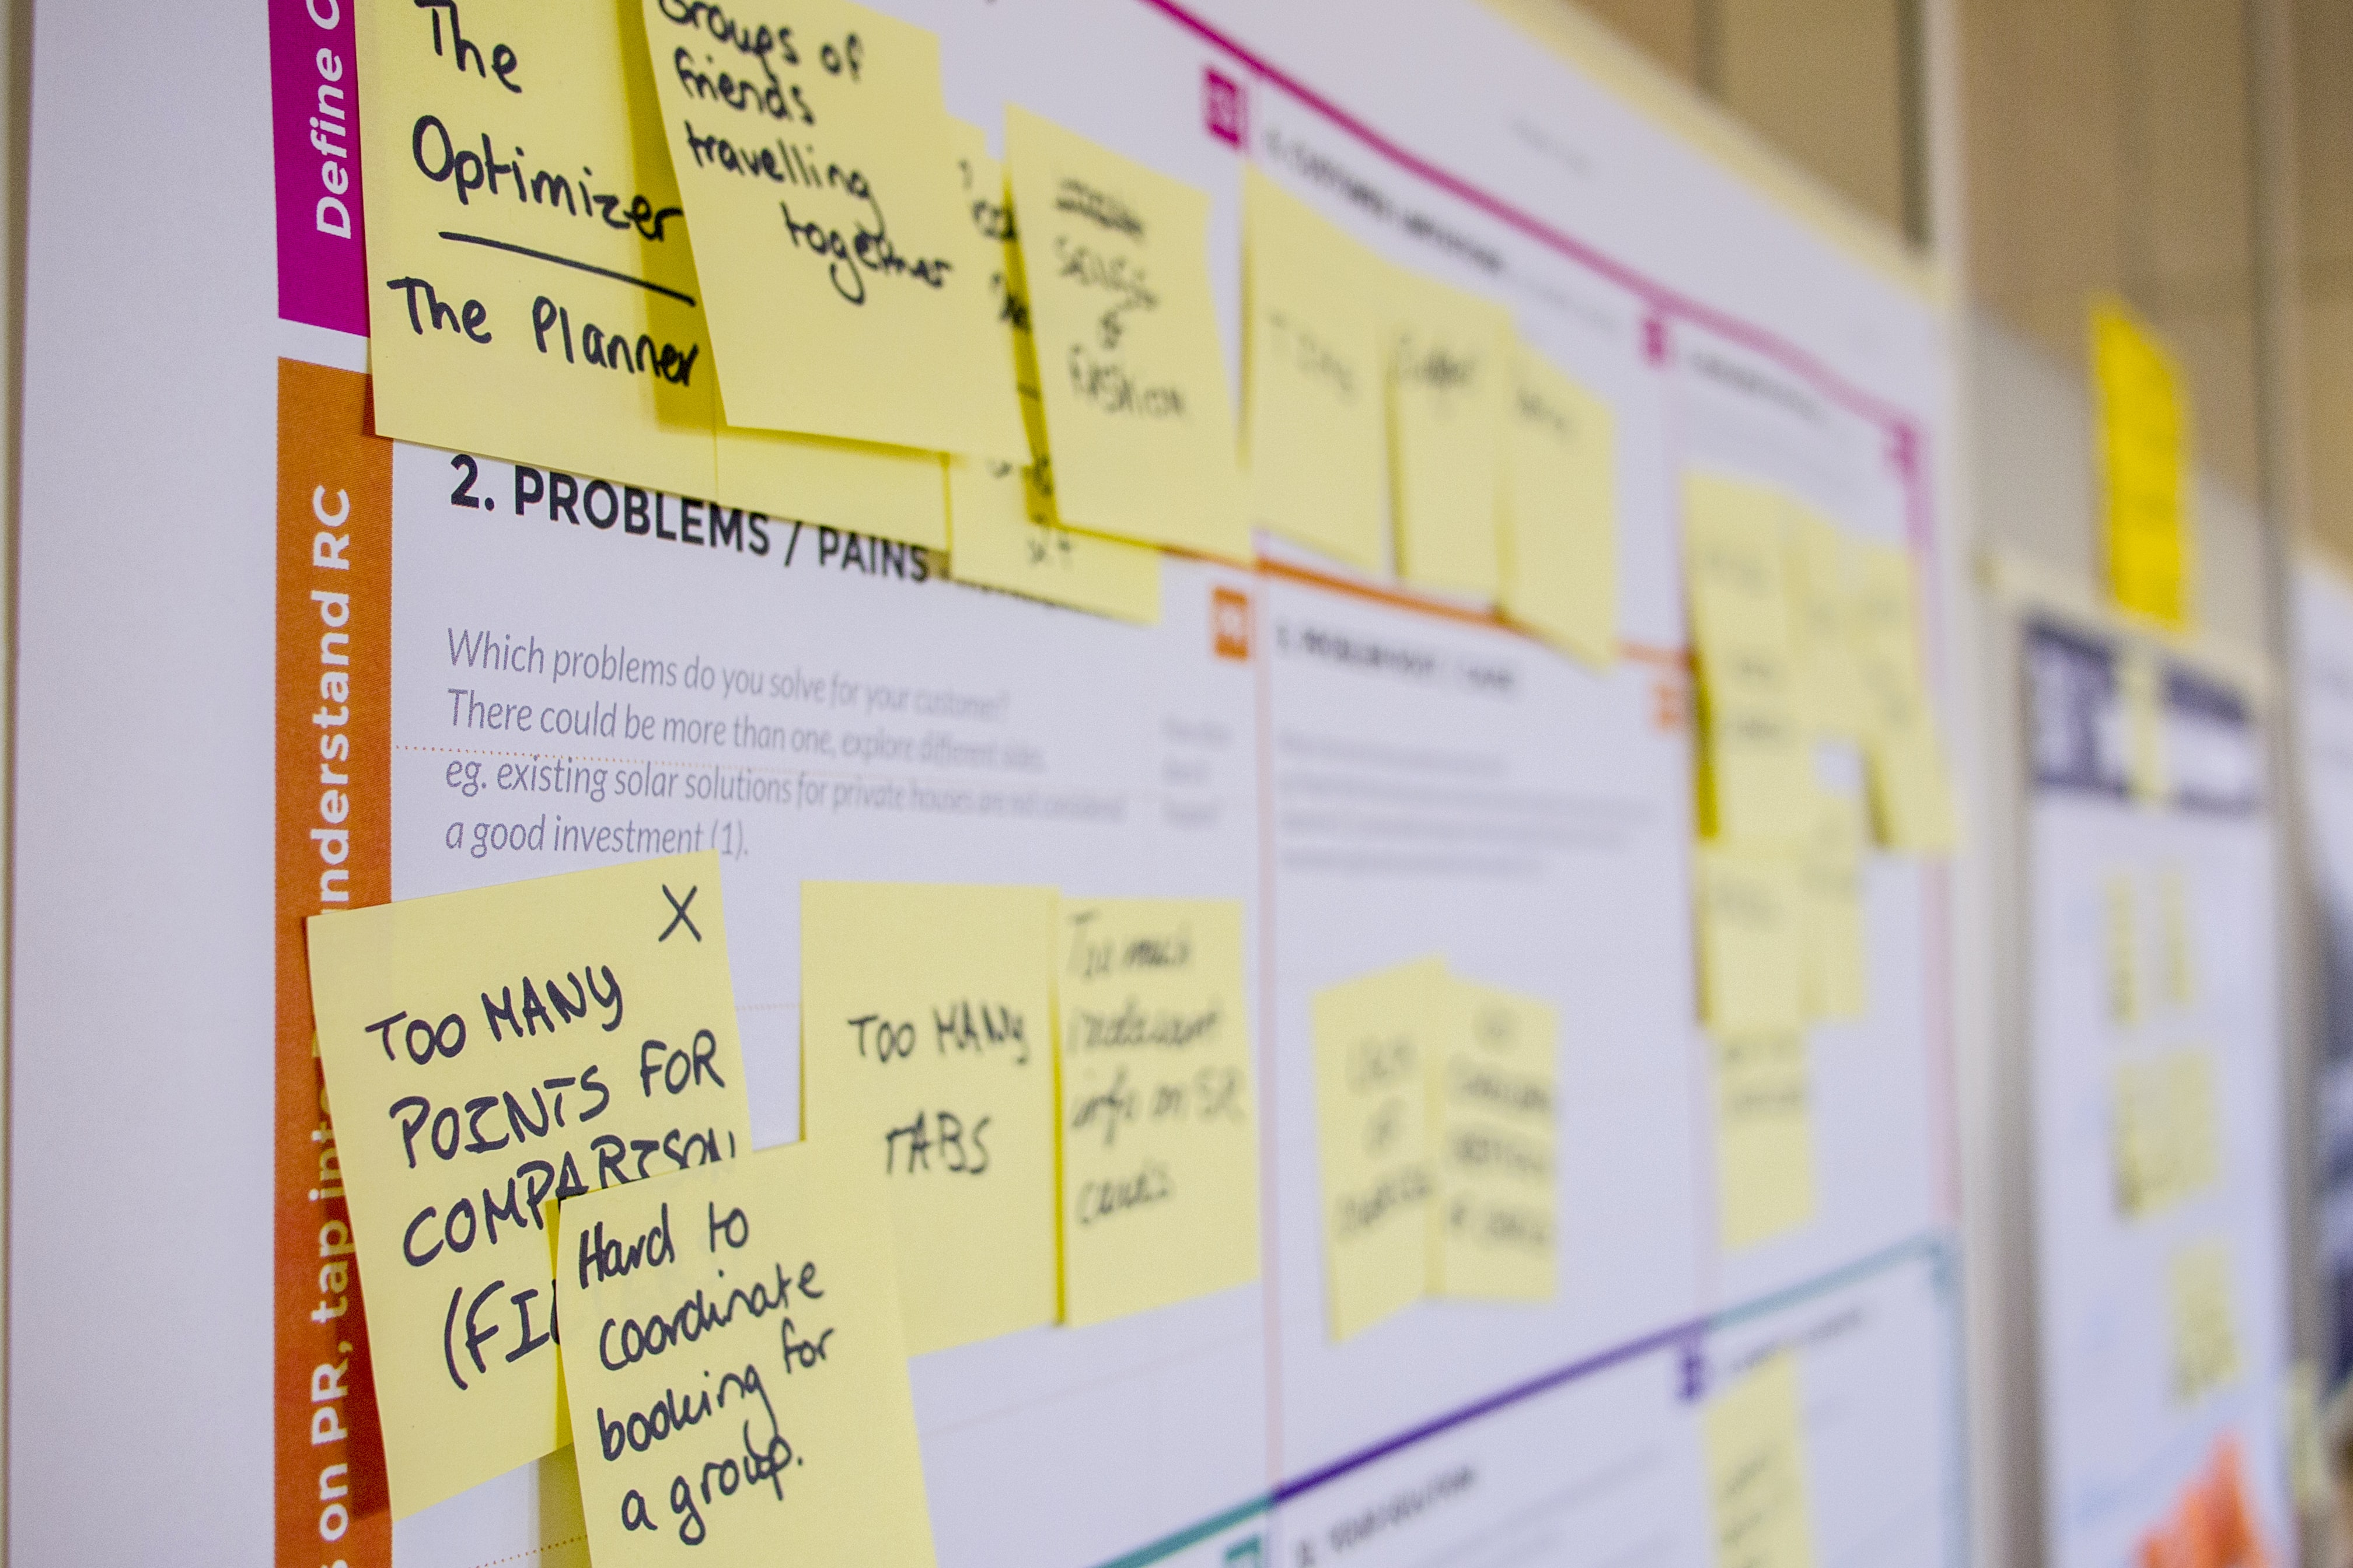

Summary
In our presentation, we've showcased two exciting projects we're currently working on during our internship. The first project involves harnessing the power of databases and Power BI to extract insightful visuals, enabling us to glean valuable insights from our data.
01
Implementing a structured workflow from company storage to database, integrating Navision data, and creating insightful reports and dashboards through visualizations enhances efficiency, scalability, and decision-making capabilities, ensuring alignment with business objectives.
02
With our internship spanning approximately four months, we're deeply immersed in learning and gaining hands-on experience with cutting-edge technologies, making this an enriching and rewarding journey of growth and discovery.
03
13
Page

Slide 14
Thank You!
Have a Great Day

